Slide 1


Enhancing Customer Satisfaction through Advanced Classification Models
Subtitle: Data Mining Assignment - Group Presentation
Group Members:
Advika kavya Parlakoti-20003401
Pradyumna Shivanandaiah-20006386
Satya Kishore Reddy Duvvi-10639744
Date: November 3, 2023
Course: Data Mining - B9BA103
Source Code: https://github.com/Pradyumna-yes/Optimizing-Airline-Customer-Satisfaction

Slide 2


Introduction to Business Problem Maximizing Airline Customer Satisfaction
Challenge: In the competitive airline industry, customer satisfaction is a key differentiator that drives loyalty and revenue.
Objective: To leverage data mining techniques to predict customer satisfaction levels and uncover factors that influence positive experiences.
Dataset Insight: Utilized a dataset with over 100k+ samples, encompassing features such as age, gender, customer type, travel class, flight distance, and service ratings.
Goal: The ultimate goal is to build a robust classification model that can accurately classify customers as 'satisfied' or 'neutral/dissatisfied', enabling the airline to tailor services and improve overall customer experience.

Slide 3
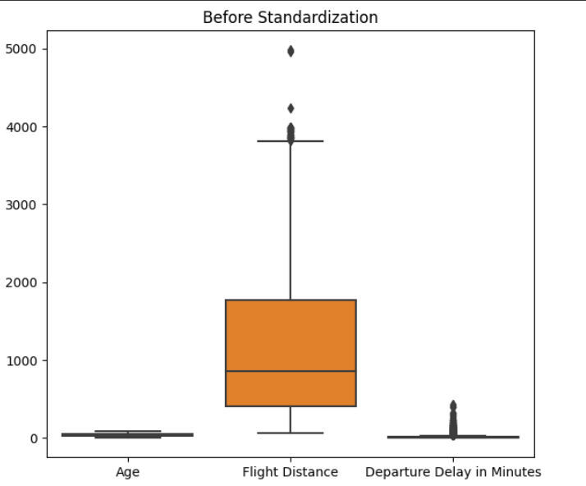
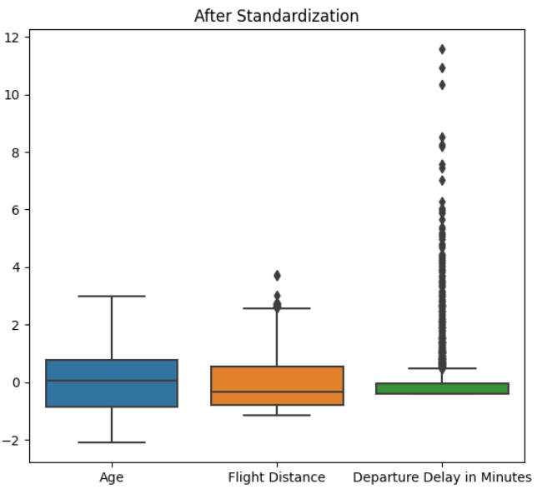
Data Quality in Context of Business Objectives
Data Integrity: Over 100K entries with 10+ variables, prepped for predictive modeling.
Missing Values: Mean imputation applied to numerical fields to maintain dataset completeness.
Categorical Encoding: Conversion of categorical to numerical to facilitate model ingestion.
Feature Standardization: Standardized numerical features to neutralize scale biases.
Relevance to Business Problem: Dataset features selected to directly influence customer satisfaction prediction.

Slide 4
Model Performance Evaluation Criteria
Evaluation Metrics Explained:
Our model assessment relies on accuracy, precision, recall, F1 score, and ROC AUC to ensure a comprehensive evaluation.
Accuracy measures overall correctness, precision focuses on the reliability of positive predictions, recall assesses the model's ability to identify all relevant cases, F1 score provides a balance between precision and recall, and ROC AUC reflects performance across all classification thresholds.
Business Impact of Prediction Errors:
False Positives (predicting satisfaction incorrectly): May lead to complacency in service improvement, risking future customer loyalty and revenue.
False Negatives (missing unsatisfied customers): Critical as it may result in loss of customers and tarnish brand reputation if not addressed promptly.
Financial Implications of Model Choices:
Our analysis incorporates potential financial losses from prediction errors, emphasizing models that minimize costly mistakes.
The chosen metrics facilitate a decision-making framework that prioritizes customer retention and satisfaction, integral to long-term profitability.
Recommendation for Model Adoption:
We recommend the Random Forest model, which offers a compelling balance between prediction accuracy, processing speed, and associated costs.
Random Forest strikes a balance between accuracy, speed, and cost, making it an optimal choice for our business needs.

Slide 5
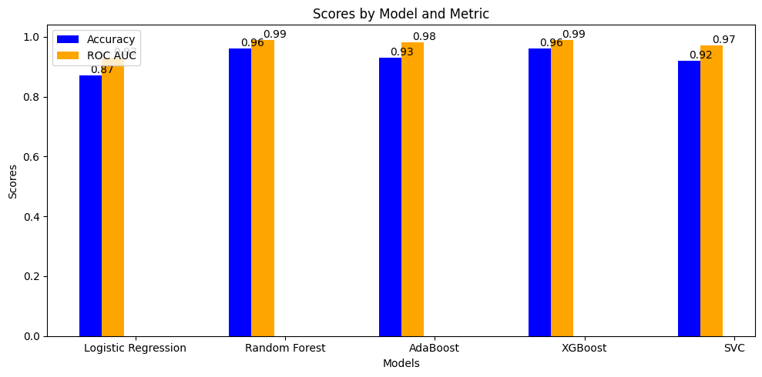
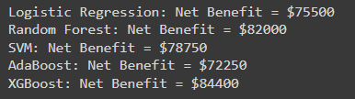
Comparative Analysis of Model Performances
Model Overview: Evaluated models: Logistic Regression (LR), Random Forest (RF), Support Vector Machine (SVM), AdaBoost, and XGBoost. Objective: Select the optimal model for predicting airline customer satisfaction.
Performance Metrics Summary: Metrics include Accuracy, Precision, Recall, F1 Score, ROC AUC and CM These metrics provide a holistic view of model performance.
Numerical Performance Comparison: Logistic Regression: Acc: 87%, Prec: 87%, Recall: 87%, F1: 87%, ROC AUC: 93% Random Forest: Acc: 96%, Prec: 96%, Recall: 96%, F1: 96%, ROC AUC: 99% AdaBoost: Acc: 93%, Prec: 93%, Recall: 93%, F1: 93%, ROC AUC: 98% XGBoost: Acc: 96%, Prec: 96%, Recall: 96%, F1: 96%, ROC AUC: 99% SVC: Acc: 92%, Prec: 92%, Recall: 91%, F1: 92%, ROC AUC: 97%
Trade-offs & Selection: LR is less complex, providing ease of interpretation but lower performance. SVM offer high precision but require complex tuning. AdaBoost is less sensitive to overfitting but may be affected by noisy data. XGBoost & RF offers the highest performance across all metrics, indicating its superior predictive power but based on the real-life matrix we are going ahead with RF

Slide 6
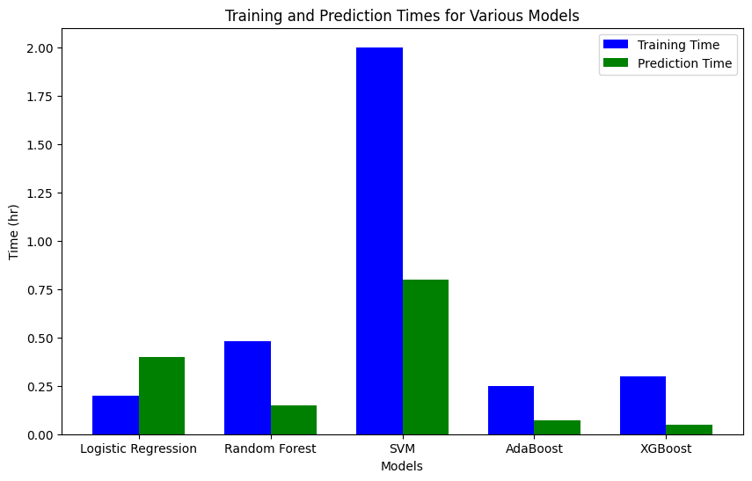
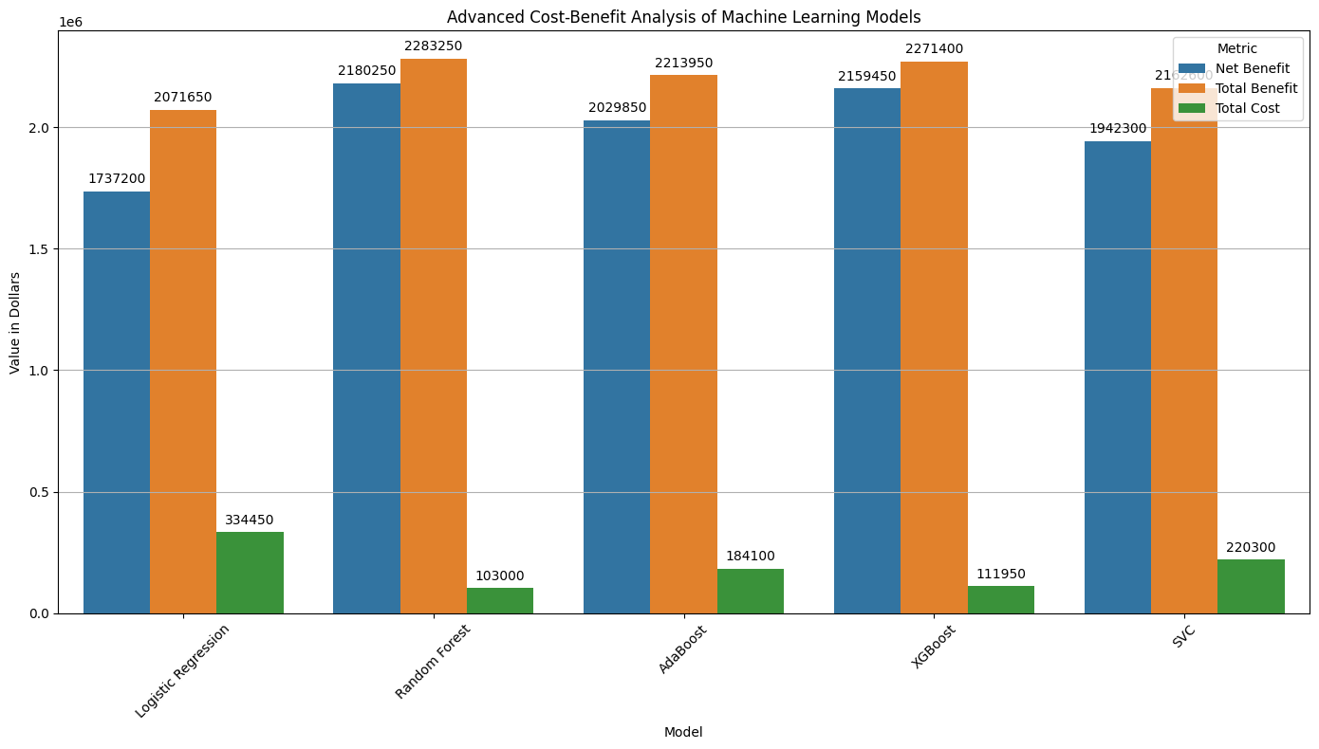
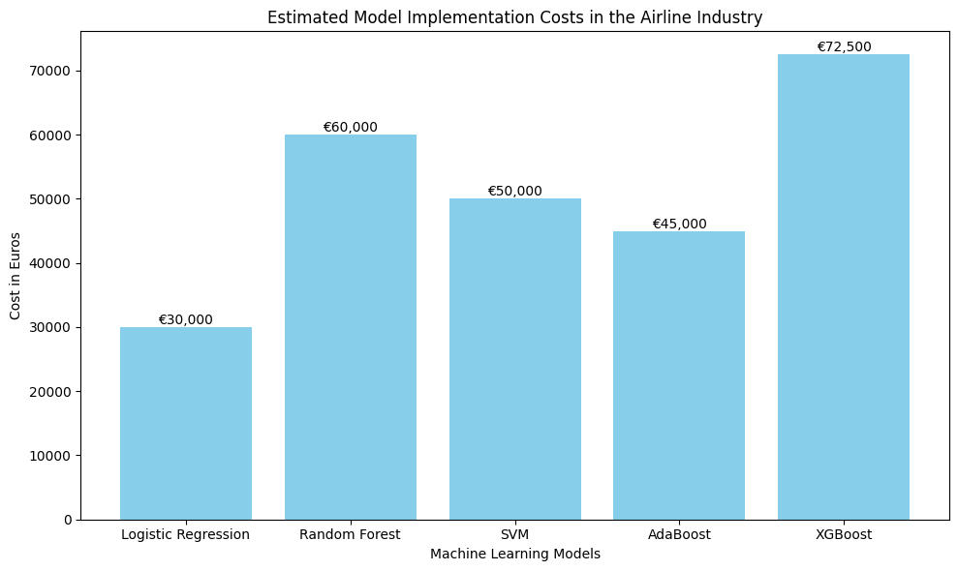
Model Comparison Matrix

Slide 7
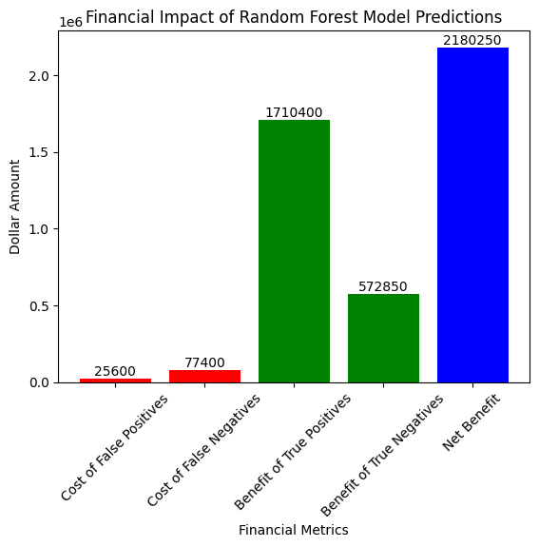
Business Impact of Model Performance
Cost Assumptions:
False Positives (FP): Incorrect predictions result in misallocated resources, costing approximately $100 per incident.
False Negatives (FN): Failure to accurately predict positive outcomes leads to missed opportunities or additional costs, estimated at $150 per incident.
True Positives (TP): Correctly identifying positive cases has a significant benefit, valued at $200 per incident.
True Negatives (TN): Accurately identifying negative cases helps avoid unnecessary actions, saving about $50 per incident.
Financial Impact Breakdown:
False Positives: For instance, 256 instances in the Random Forest model would cost 256 instances × $100 = $25,600.
False Negatives: Similarly, 516 false negatives in the Random Forest model would cost 516 instances × $150 = $77,400.
True Positives: The benefit from 8,552 true positives in the Random Forest model is estimated at 8,552 instances × $200 = $1,710,400.
True Negatives: The savings from 11,457 true negatives in the Random Forest model are 11,457 instances × $50 = $572,850.
Total Expected Financial Impact:
The model's total cost due to inaccuracies: $25,600 (FP) + $77,400 (FN) = $103,000.
Total potential savings and benefits from TP and TN: $1,710,400 (TP benefit) + $572,850 (TN savings) = $2,283,250.
Conclusion
The Random Forest model demonstrates superior financial performance in the cost-benefit analysis, outperforming other models with a net benefit of $2,180,250

Slide 8

Interpretation of the Random Forest Performance
High Accuracy (96%): Ensures precise identification of customer satisfaction levels, crucial for effective customer service strategies in airlines.
Exceptional Precision (96%): Guarantees accurate predictions of customer satisfaction, minimizing misinterpretations and improving resource allocation for service enhancements.
Outstanding Recall (96%): Enables effective recognition and retention of satisfied customers, vital for maintaining loyalty and positive brand image.
ROC AUC of 0.99: Demonstrates the model's superior ability to distinguish between satisfied and dissatisfied customers, ensuring reliable predictions for important decisions.
Industry Application: The model's precision aids in enhancing service quality, managing brand reputation, and boosting customer loyalty in airlines through better understanding of satisfaction drivers.
Strategic Decision-Making: Provides insights for personalized customer engagement, service improvement, and data-driven decisions, leading to greater customer retention and revenue.
Competitive Advantage: Offers airlines a significant edge by enabling rapid adaptation to customer needs, market trend anticipation, and overall experience enhancement

Slide 9
Recommendations
Given the model's robust performance, the following recommendations are proposed:
Implementation for Customer Feedback Analysis: Integrate the RM model into the customer feedback processing pipeline to accurately identify and address customer satisfaction issues.
Resource Allocation: Utilize the model's predictions to effectively allocate resources towards customers most likely to be dissatisfied, thereby potentially reducing customer churn.
Further Model Tuning: Continue to refine the model by exploring additional hyperparameter tuning, feature engineering, or even ensemble methods to further improve the recall for satisfied customers.
Business Process Adjustments: Adjust business processes based on insights gained from model predictions to enhance overall customer satisfaction and loyalty, which are crucial for long-term business success.
Cost-Benefit Analysis: Conduct a comprehensive cost-benefit analysis periodically to ensure the model continues to provide value and adjust strategies accordingly.
By following these recommendations, the business is expected to enhance its customer satisfaction levels, reduce potential revenue losses from dissatisfied customers, and ultimately, drive a more data-informed customer relationship management strategy.

Slide 10

Thank You & Questions

